Slide 1

Artificial Intelligent introduction
Presenter: Hieu Dang

Slide 2
Agenda
Introduction
Aspects of AI
Problems
How to start?
What things you need to prepare?
Reference

Slide 3
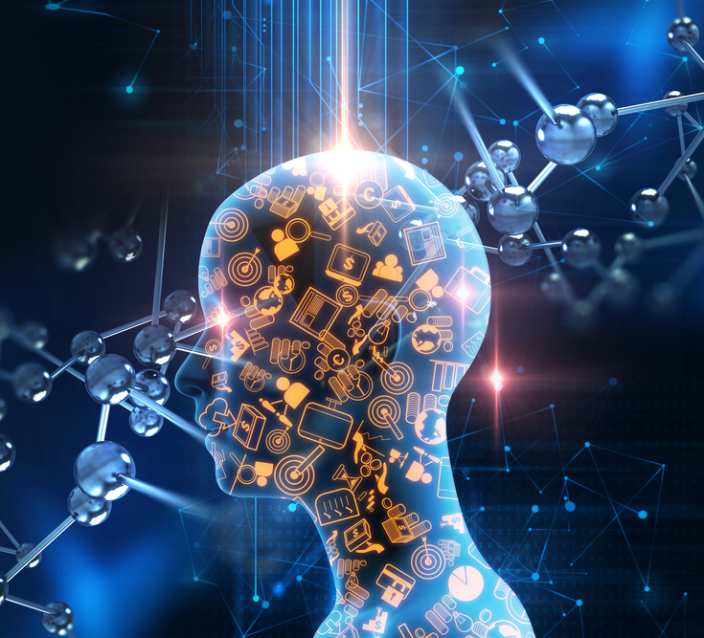
Introduction
Notes:
AI = Artificial Intelligent

Slide 4
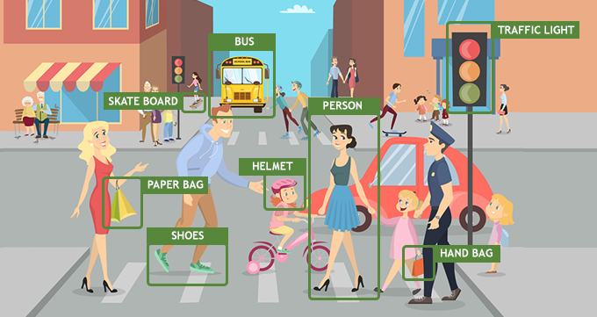
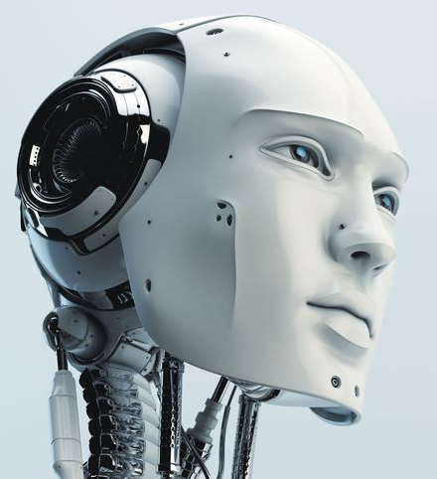
Introduction
- Guide machine thinking, acting like human.

Slide 5
Aspects of AI
Notes:
AI = Artificial Intelligent

Slide 6
Aspects of AI
AI
Computer Vision
Machine Learning
Data Science
Natural Language Processing

Slide 7
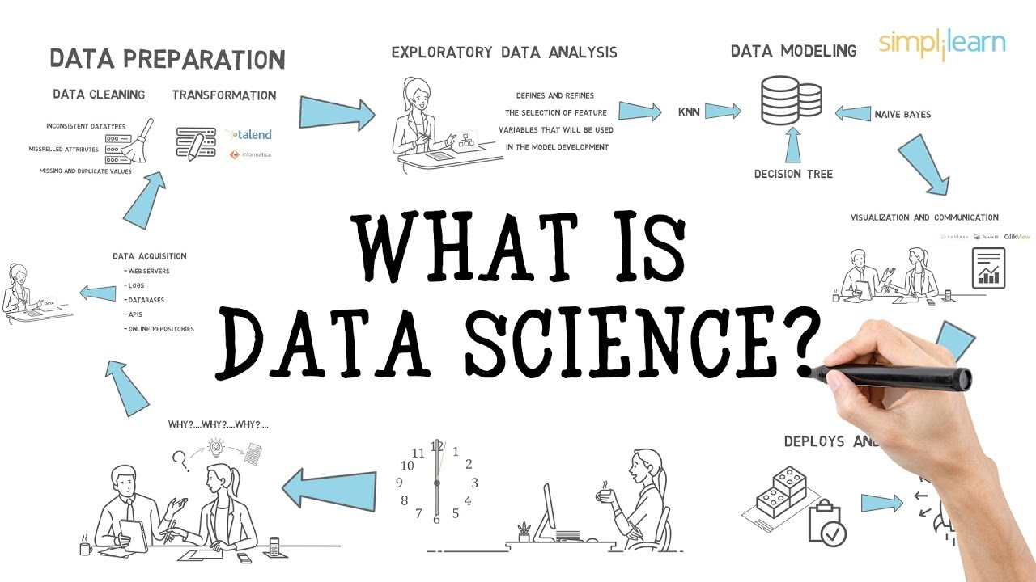
Aspects of AI
1. Data science

Slide 8
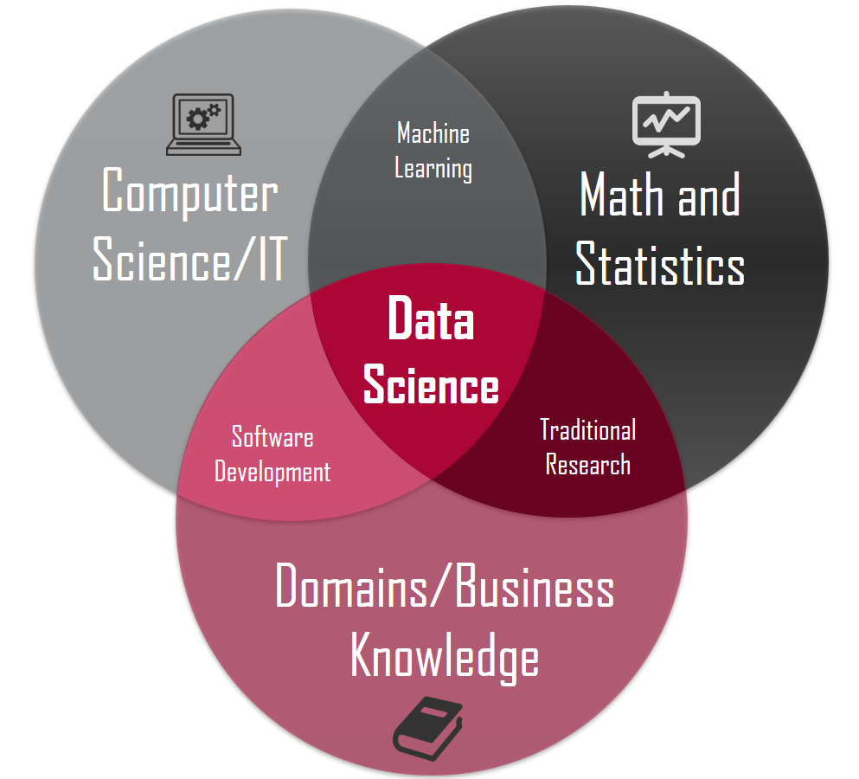
Aspects of AI

Slide 9

Aspects of AI
1. Computer vision
Computer Vision is a field of deep learning that enables machines to see, identify and process images like humans.

Slide 10
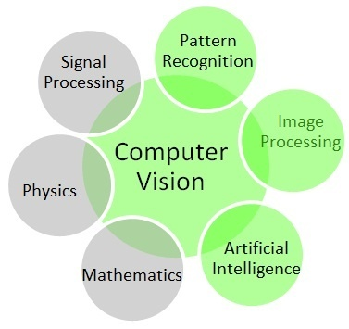
Aspects of AI
1. Computer vision

Slide 11
You need to prepare
Analytics
Linear algebra
Discrete mathematic
Graph theory
Statistics and probability

